Slide 1
CodeEZ. AI
July 2024

Slide 2

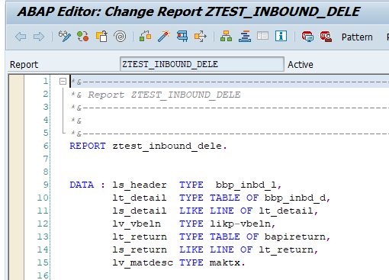
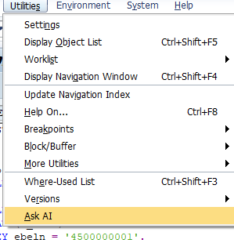
Improving Developer Productivity & Code Quality using CodeEZ. AI
Provides recommendations to the developer on source code based on free text
Faster coding cycle
Reduced defects
Productivity Improvement
Suggest Code
SAP ABAP
Editor
SE38
Reviews the existing code for correctness
Provides recommendations on best practices to be followed
Provides performance improvement recommendations
20%-30%
Review Code
Document Code
Document legacy code
Generate Technical documentation from code
Generate business process documentation from code

Slide 3






Improving Developer Productivity & Code Quality using CodeEZ. AI
Key challenge solved
Applicable across industries
CHALLENGE
RESULTS
Code not aligned to best practices
Higher development cycle
Insufficient code documentation
Higher time spent on understanding legacy code
20-30% developer productivity improvement
50% faster development lifecycle
SOLUTION
CodeEZ.AI helps
Code generation
Code review
Code documentation
40% effort reduction for code documentation

